Slide 1
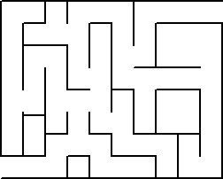
Stage 2: Maze
http://gamedev.stackexchange.com/questions/21001/find-sub-graphs-in-a-graph
What do you remember from the last activity?
What was your favorite part?

Slide 2
Objective
Students will:
Create a program for a given task using sequential steps
Count the number of times an action should be repeated and represent it as a loop
Analyze a problem and complete it as efficiently as possible
Employ a combination of sequential and looped commands to reach the end of a maze

Slide 3
Example #1
Get the zombie to the flower
Use the blue movement blocks
How many do you need?
Notes:
The answer would be “when run- move forward (3x)”

Slide 4
Example ( more challenging)
Use the repeat block to get the zombie to the flower.
Notes:
Add “repeat 5 times” under the “when run” block. Then add the “move forward” block inside the repeat box. Reasoning is because you are only limited 3 block as you may say above the given example.

Slide 5
Directions
Complete Stage 2: Maze
Progress your way through the stage

